Slide 1
J’s Rise & Shine
Pre & Primary School

Slide 2
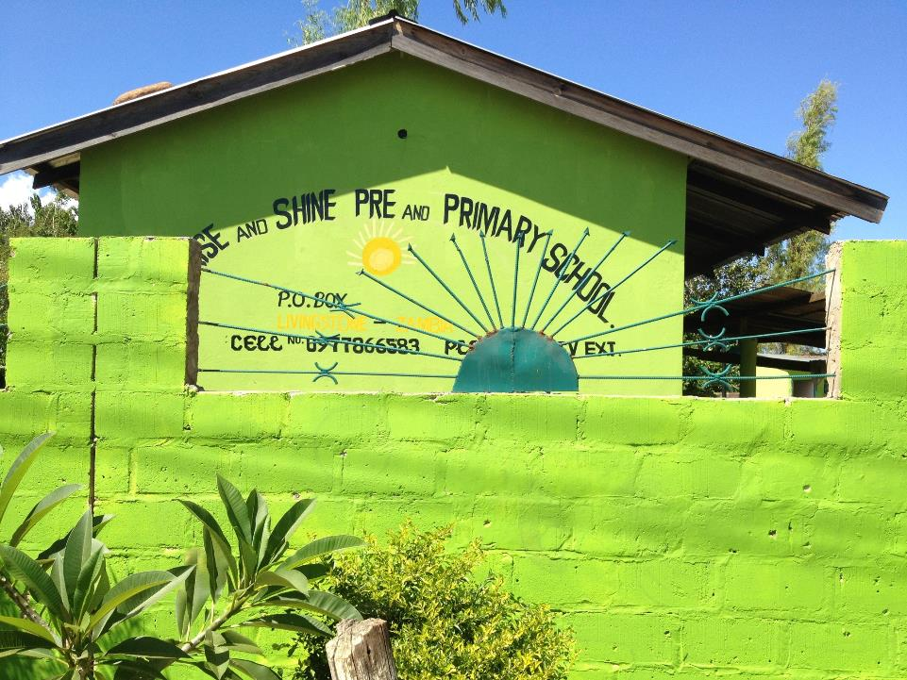

Slide 3
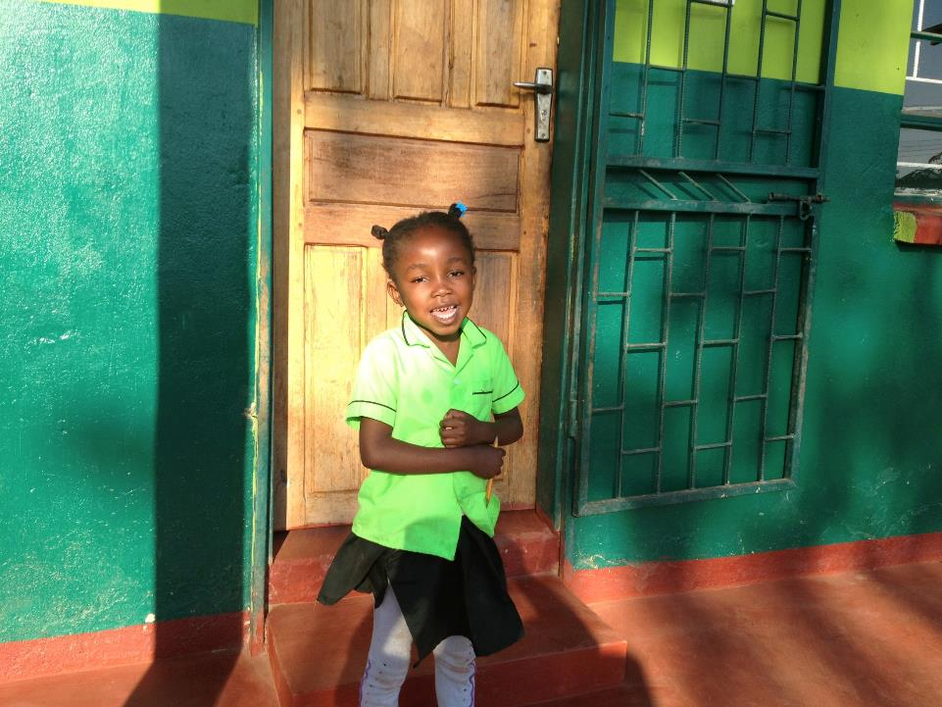

Slide 4
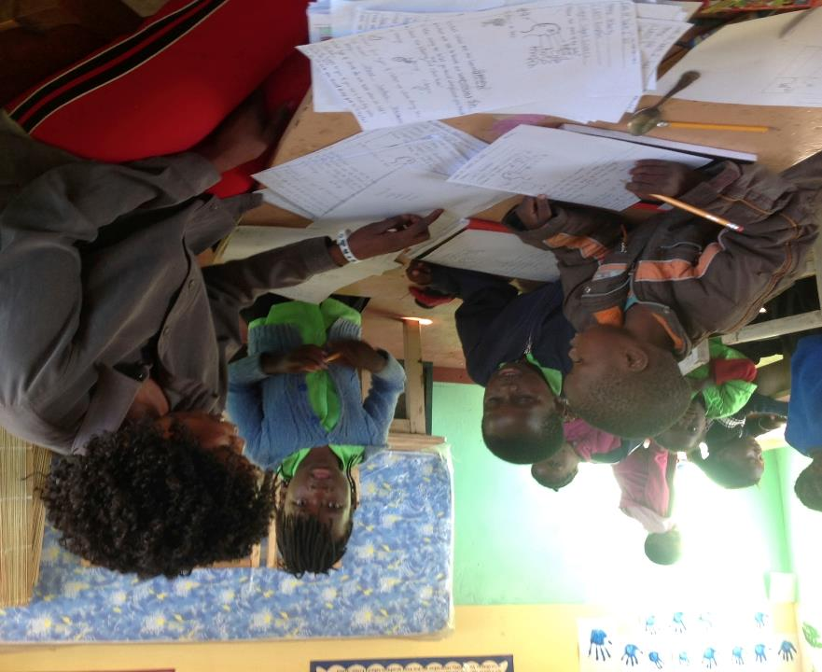

Slide 5
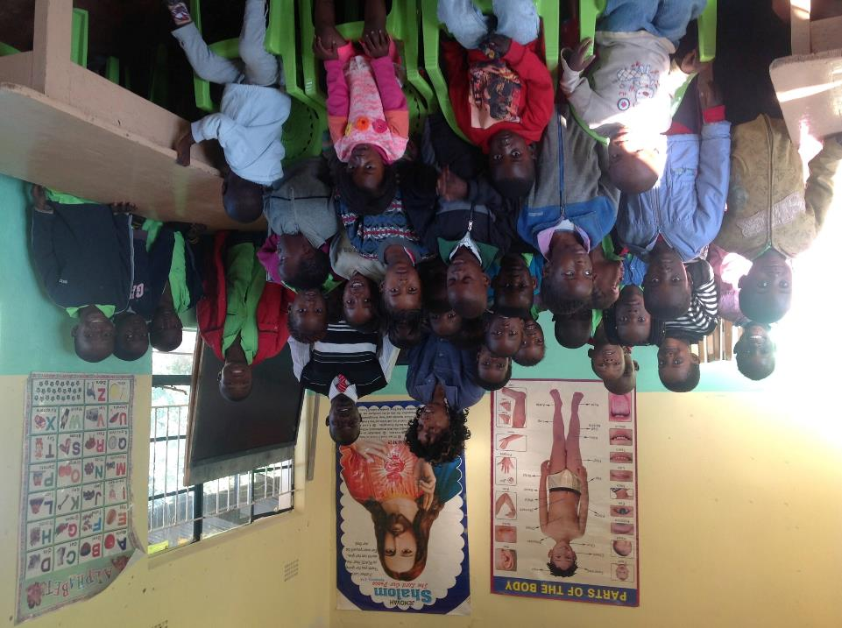

Slide 6
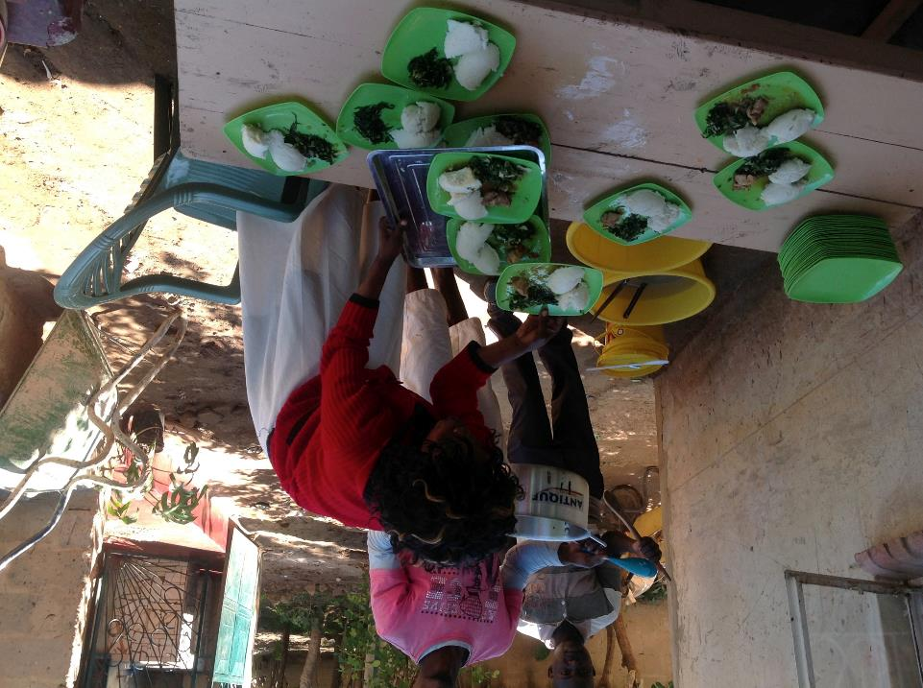

Slide 7
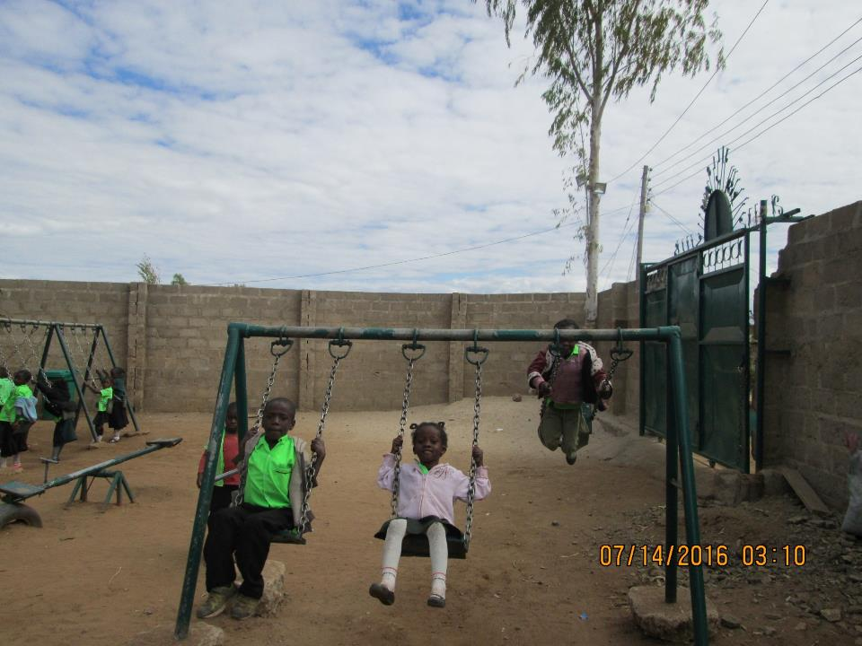
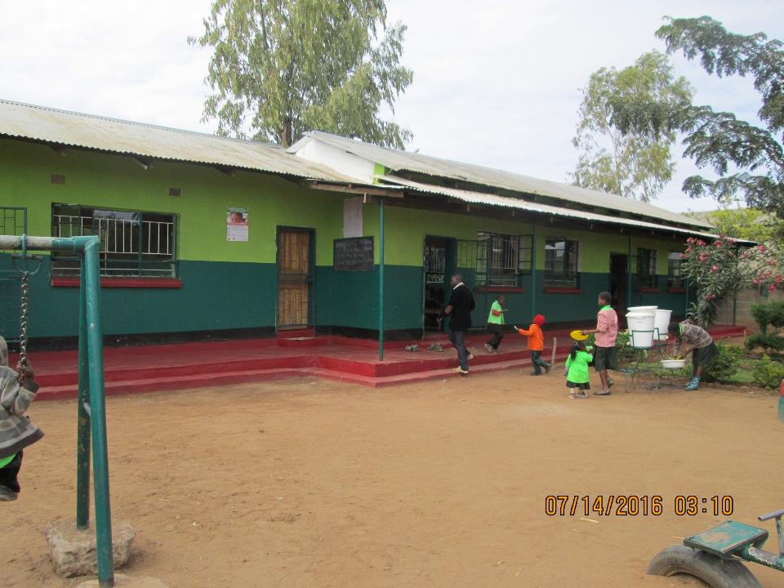
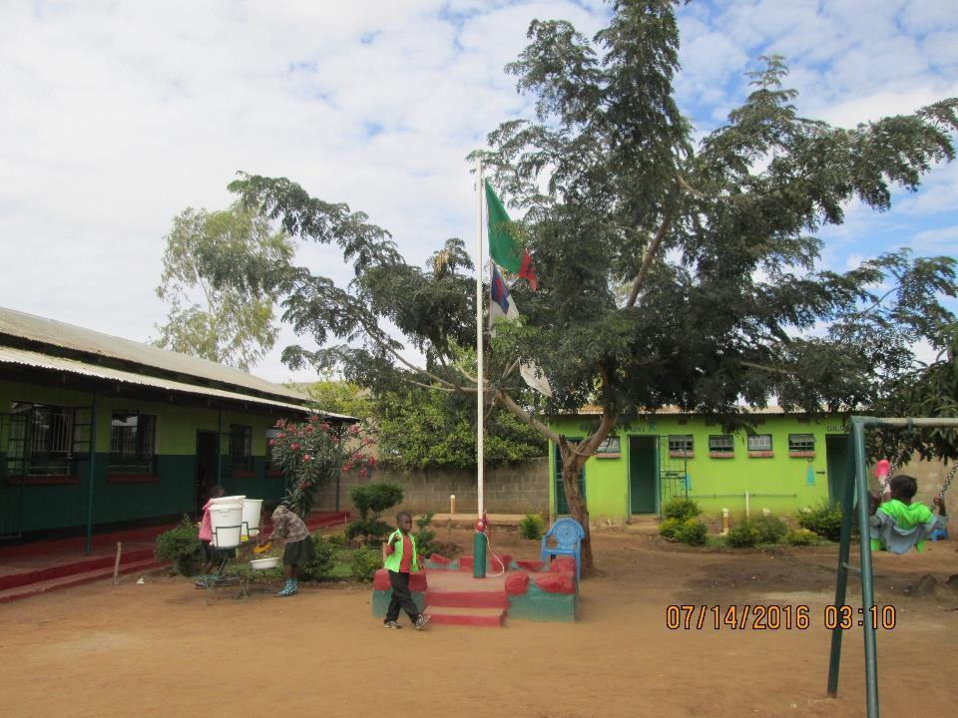
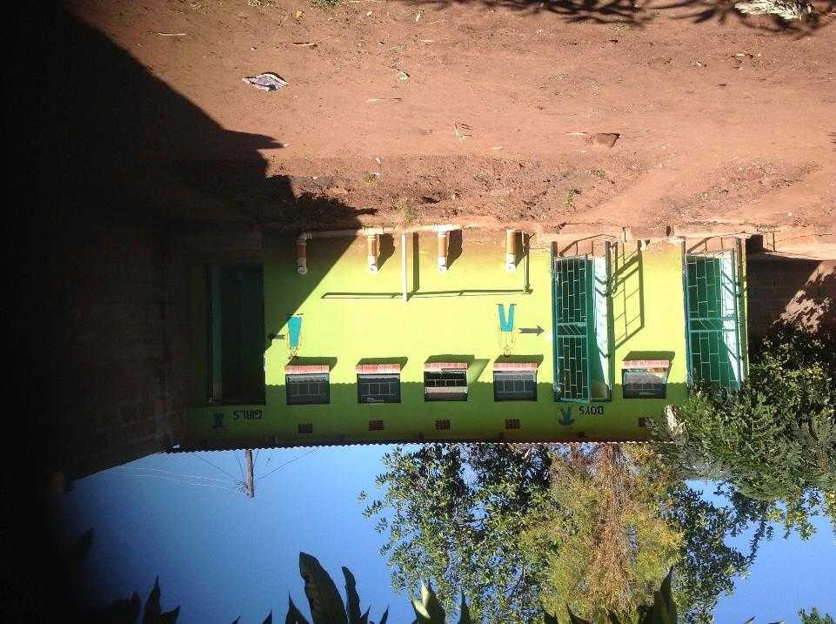

Slide 8
J’s Rise & Shine
We currently have 82 orphans & vulnerable children. All of them, our teachers and staff all know the J stands for JESUS! As our school is a place where Christ is the Headmaster.
“ J’s Rise & Shine is a beacon of hope in an area that is really of need of it. J’s is a wonderful model for what schools could be like. It is clean, organized and inviting. It is a safe space for children to learn and grow. It is a place where Christ and His love is proclaimed”
Dr. Ashley Espinal, Director Honey Rock Foundation

Slide 9
J’s Rise & Shine
In 2016 we built our school kitchen and serving area, along with one guesthouse for volunteers and another under construction.
Our students are provided with a uniform and receive two nourishing meals each school day, along with a quality education and most importantly the love & knowledge of Jesus!
The cost of sponsoring an orphan is $300 for a school year [$25.00 per month]
All our teachers are Christian, experienced and Zambian certified.

Slide 11
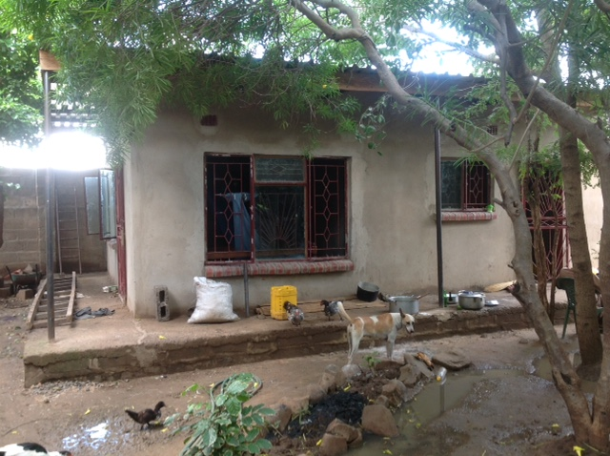

Slide 12
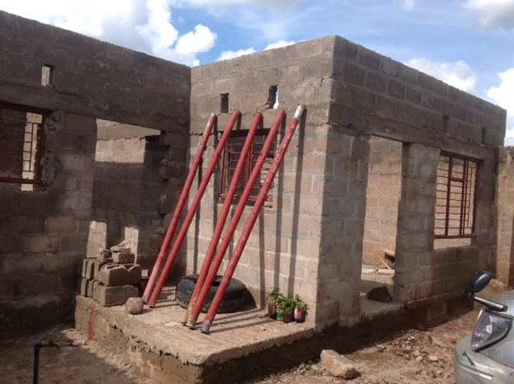

Slide 14
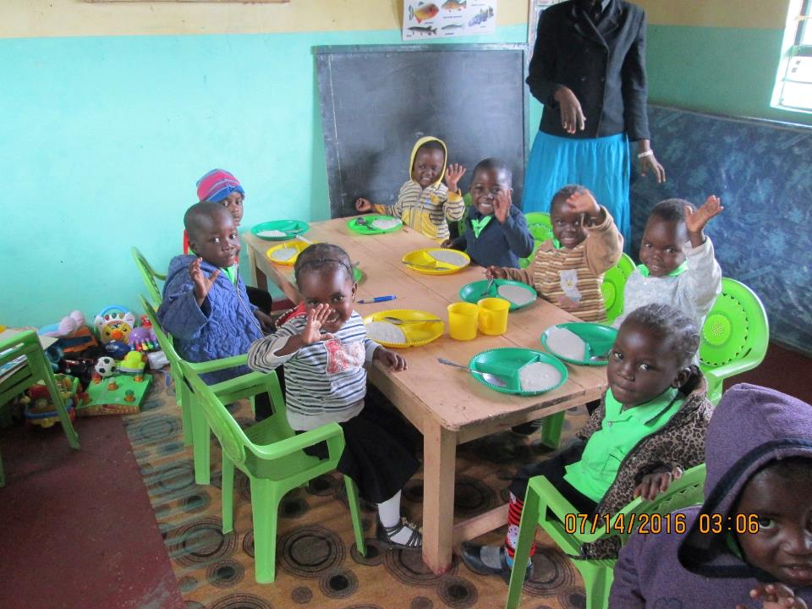

Slide 15
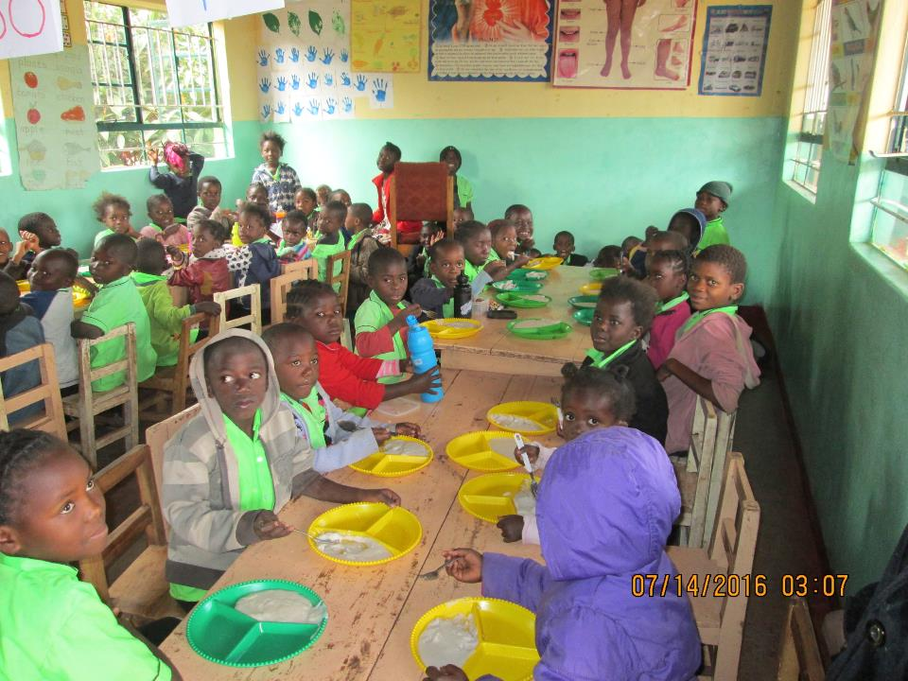

Slide 16
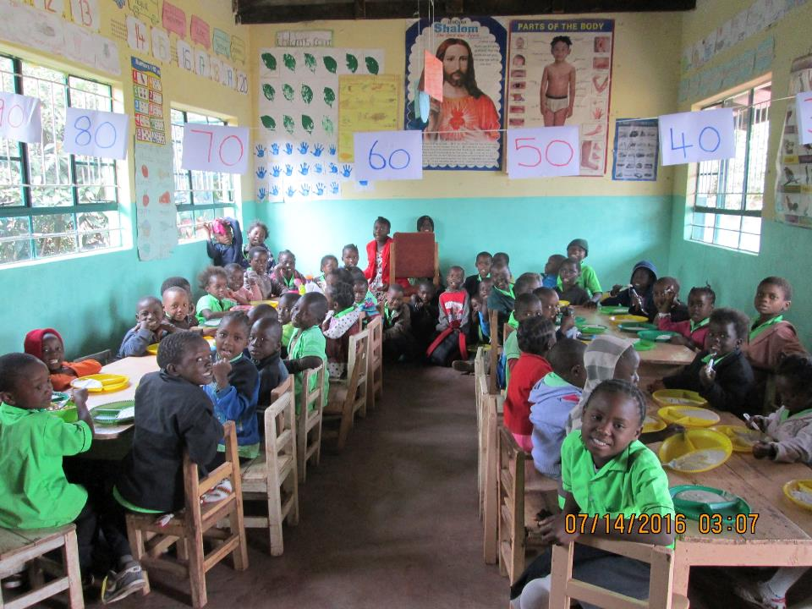

Slide 17
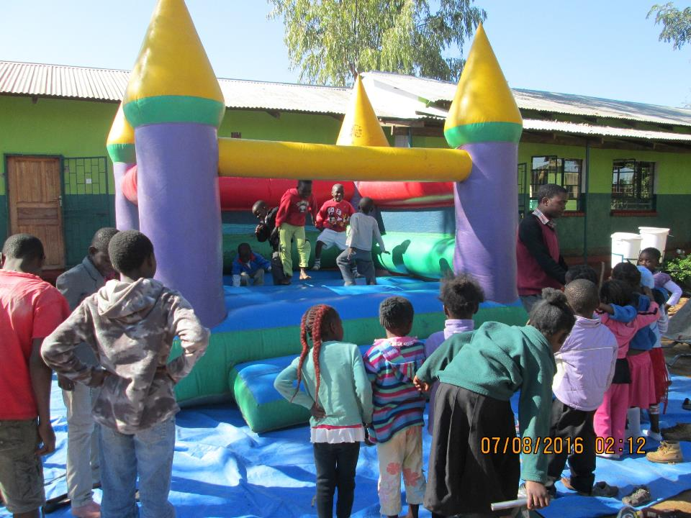

Slide 18
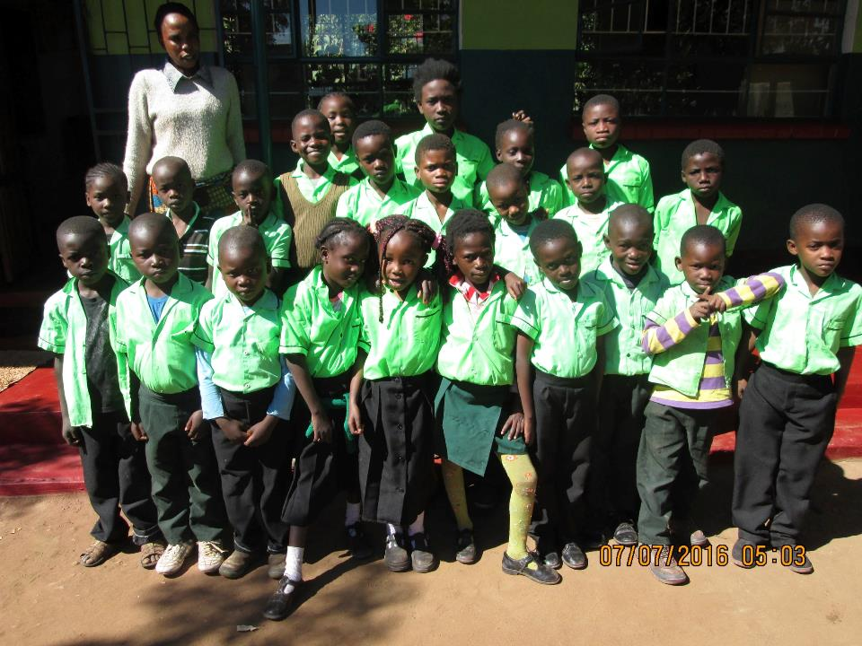

Slide 19
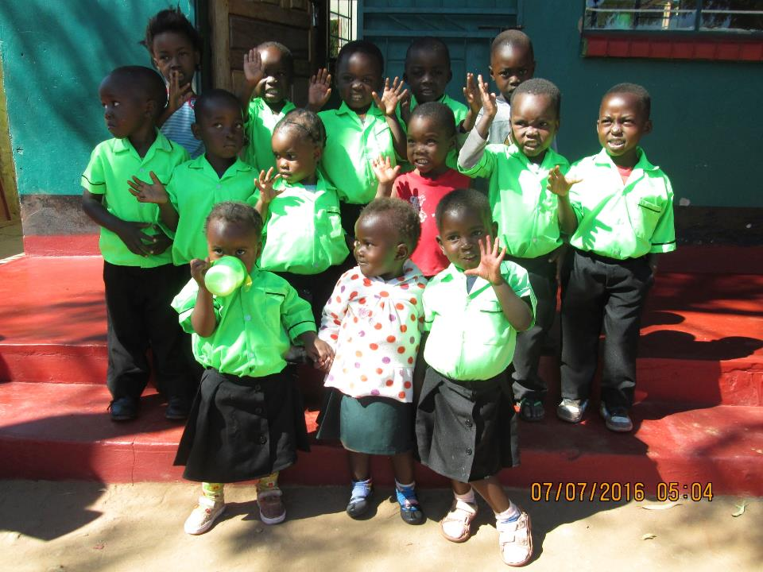

Slide 20
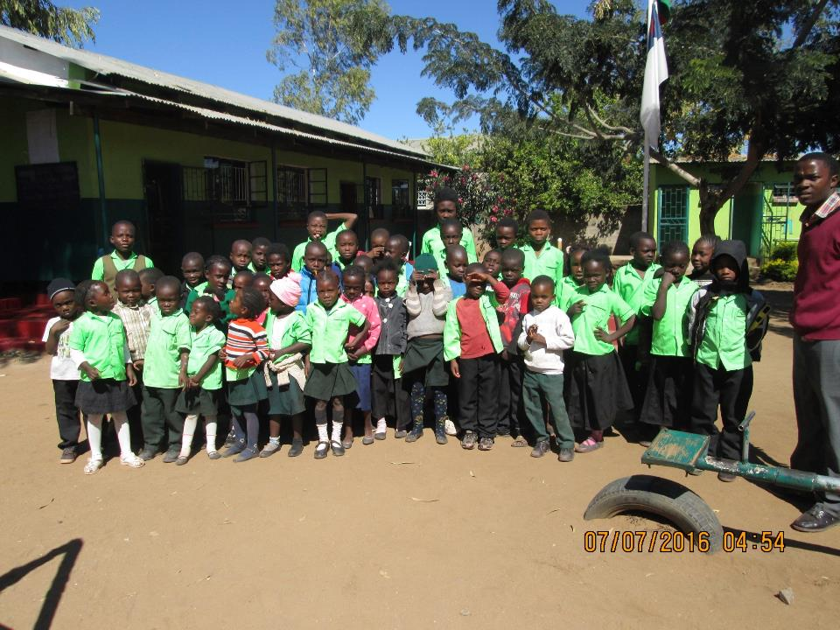

Slide 21
2016 & Beyond
Expand J’s R&S year by year to go eventually through grade eight, building additional classrooms to accommodate our students
Development of our land, Rise Farm,near the Katubya village, to plant crops and raise livestock to feed and support J’s R&S
Work within the community of Katubya to plant a church there.
Open a school on the land based on the J’s R&S model

Slide 22
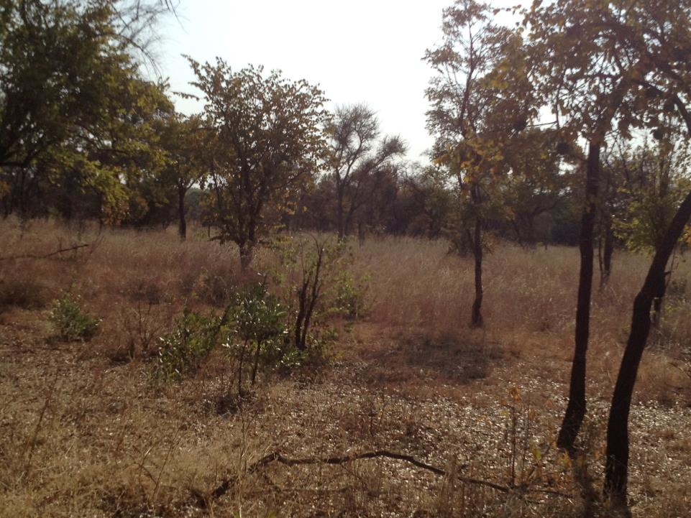

Slide 23
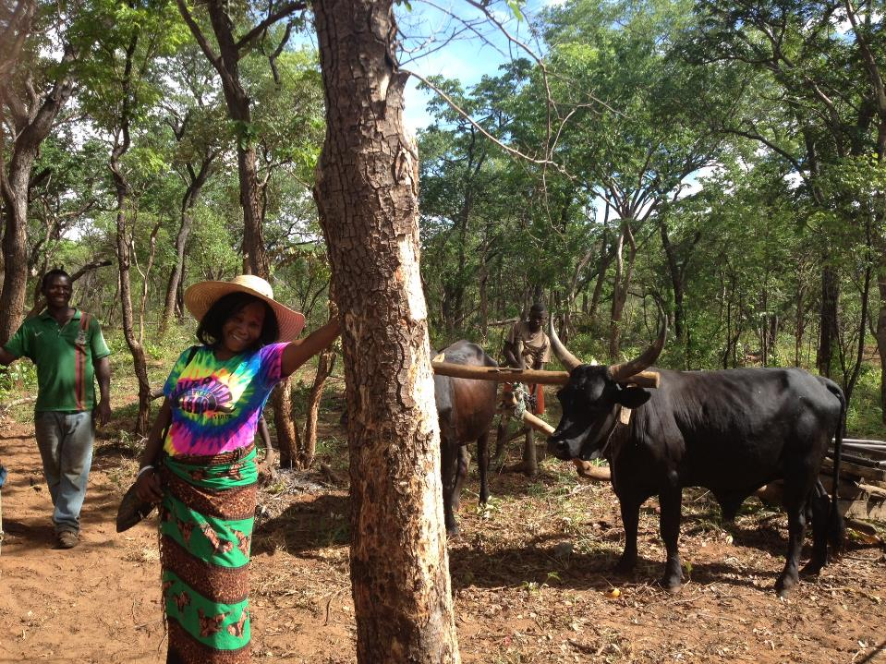

Slide 24
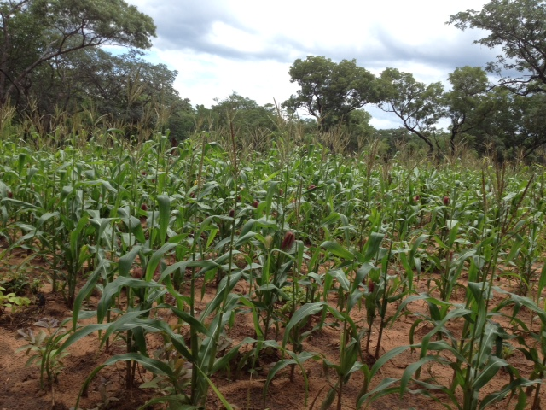

Slide 25
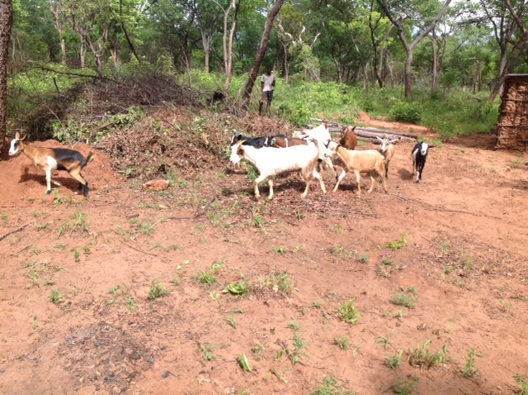

Slide 26
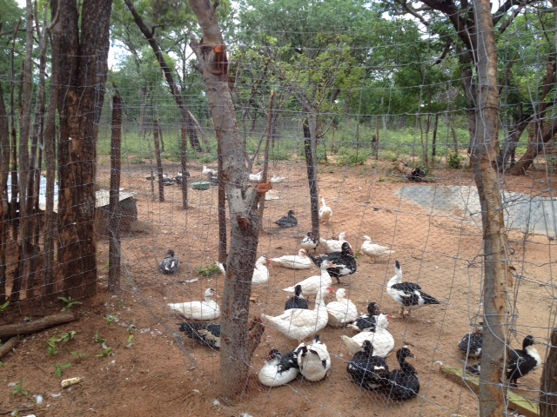

Slide 27
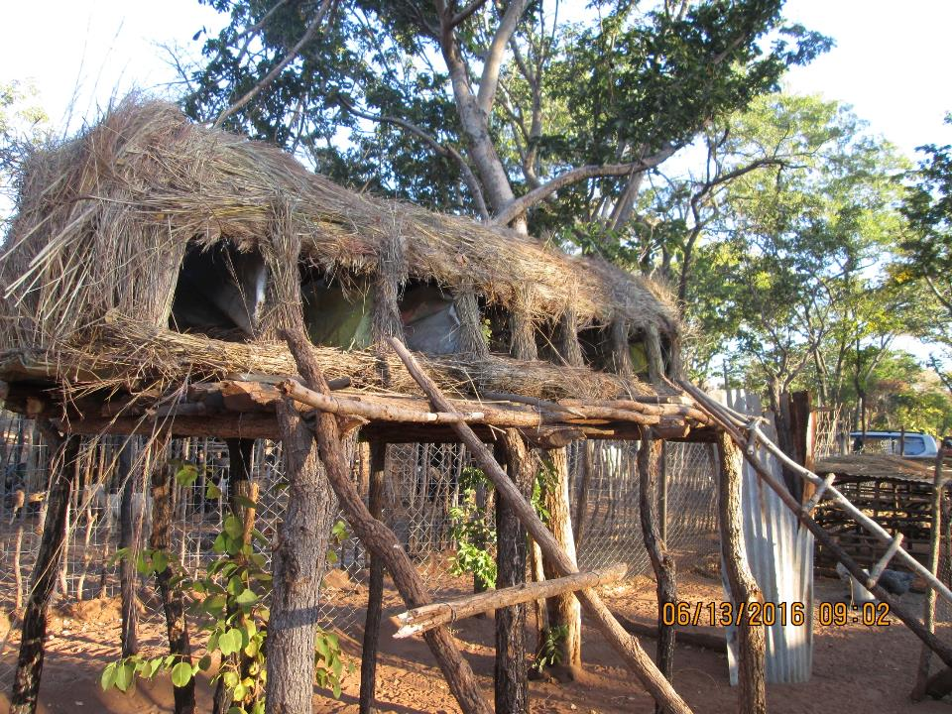

Slide 28
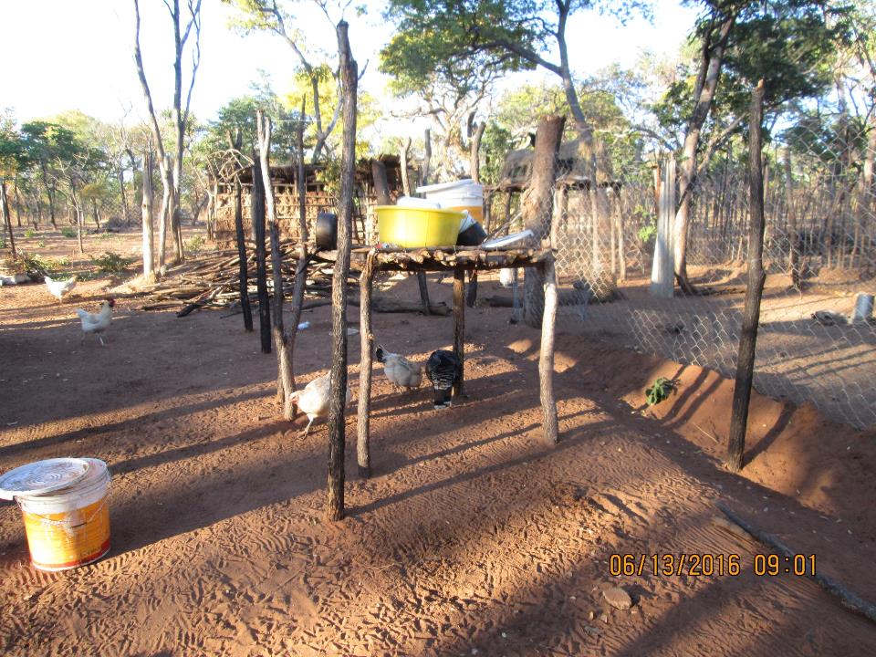

Slide 29
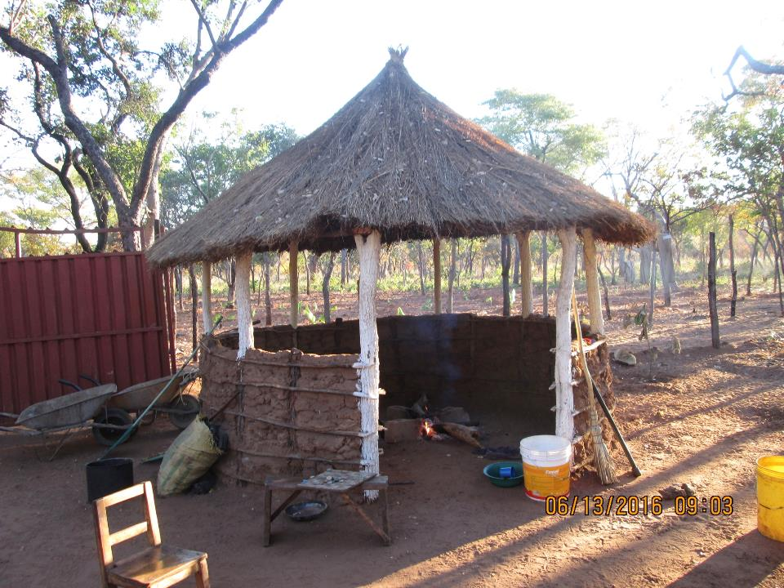

Slide 30
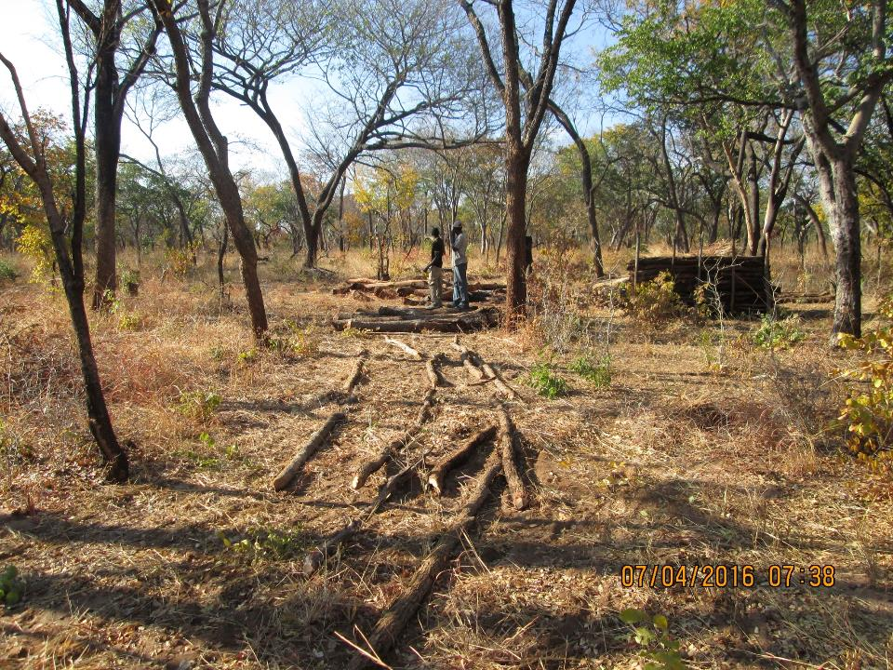
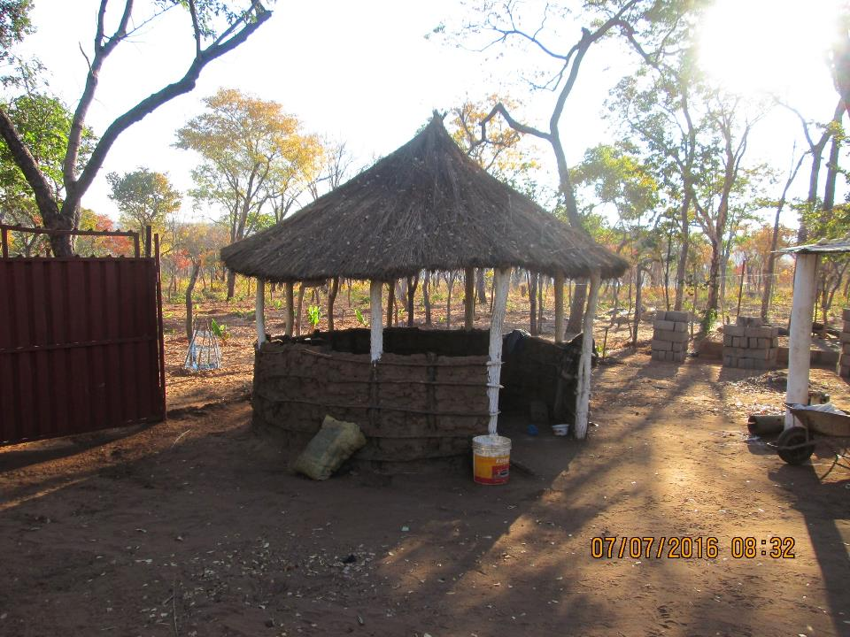
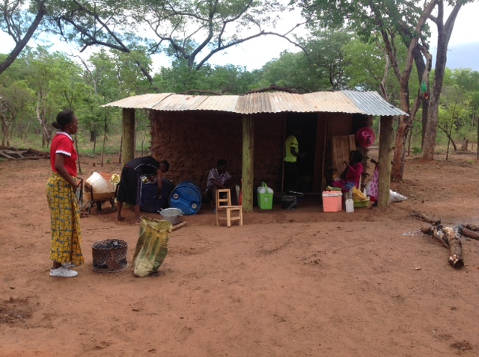

Slide 31
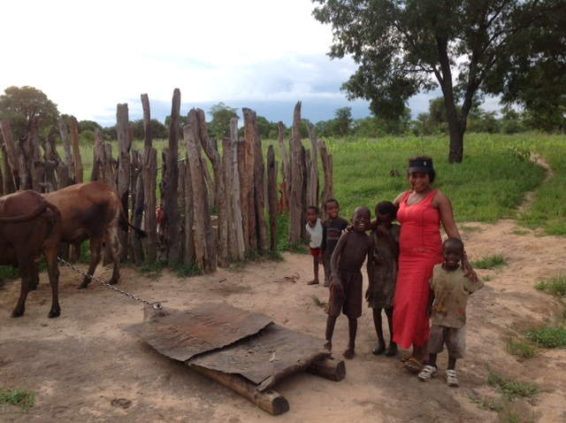

Slide 32
Summation
I received the Call from God in July of 2012 and faithfully accepted and He blessed that.
In March 2013, Life Savers of Zambia was formed to support the work for the children of Zambia and again God blessed that as funds were provided for the children and my work there.
In 2014, I decided to commit to my life to live in Zambia for the pursuit of helping orphans and vulnerable children there.
In 2015, God blessed me with a beautiful, compassionate, intelligent Zambia wife to work with me to accomplish the tasks God has set before us.

Slide 33
Monetary needs
Funds to maintain operation of J’s Rise & Shine Pre and Primary School in Dambwa Site Extension
Funds to purchase stove and oven for school kitchen, additional desks, instructional materials and photocopier
Funds to build additional classrooms
Funds to continue to work with schools & teachers to improve education at J’s Rise & Shine
Funds for maintaining & developing agricultural and small livestock projects at Rise Farm to provide food and support of J’s Rise & Shine

Slide 34
Questions & Comments Please email to jamesmangold@gmail.com

